Slide 1
Vector vs. Bitmap
V104.03
Obtained from a summer workshop in Guildford County July, 2014

Slide 2
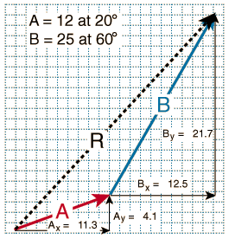
Vector Images
Vector images (also called outline images) are images made with lines, text, and shapes. Text type is considered to be vector because it is composed of lines and curves.

Slide 3
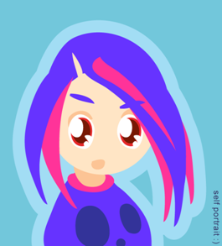
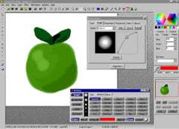
Advantages of Vector Images
Vector graphics are resolution independent, which means they can be output to the highest quality at any scale.
Vector graphic images normally have much smaller file sizes than raster-based bitmaps.
Changing or transforming the characteristics of a vector object does not effect or distort the object.

Slide 4
Advantages of Vector Images
Vector images are not limited to rectangular shapes like bitmaps.
An image can be enlarged or reduced without affecting the quality of the image.
There is no background unless it is placed behind the image as a layer

Slide 5
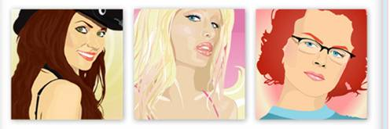
Advantages of Vector Images
Vector images have the appearance of artistic form such as cartoons.
Vector images can be easily converted to bitmap images.
Lines and curves are easily defined and will always be smooth and retain their continuity.

Slide 6
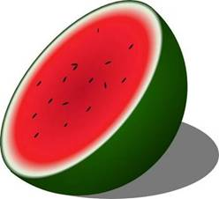
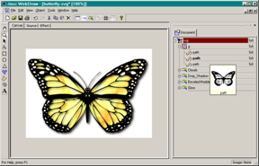
Disadvantages of Vector Images
The main disadvantage is they are not photorealistic.
Vector images are usually filled with solid or gradient colors but lack in depth and appearance in the values and colors of a true continuous tone image.

Slide 7
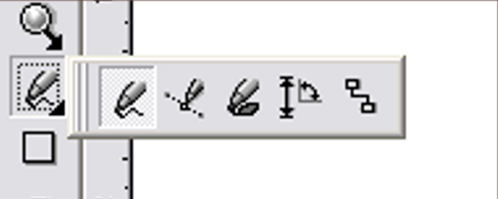
Creating Vector Images
Vector images are drawn with basic line tools available in most graphic software programs.
The freehand tool is used to produce freeform lines.
The pen tool (Bezier) is used to draw controlled curves called Bezier curves.

Slide 8
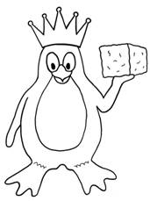
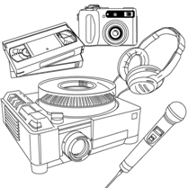
Classifications of Vector Images
Simple line art is a 1 bit graphic image with large areas of black and White.
Complex line art is made up of many curves with linear contrast but still maintains the quality of a black and white image.

Slide 9
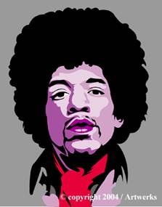

Classifications of Vector Images
High detail line art is composed of curves and stippled dots (simulates different styles of etching) to form values.
Colored vector images are composed of lines, solid colors, blended or gradient colors to simulate tonal changes and are produced using different color methods (opaque or transparent).

Slide 10

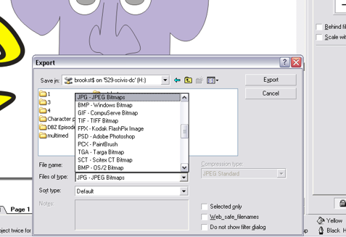
Common Rules for Vector Images
A common rule for vector images is to save the image in its native format in the software program being used first, and then convert the image into other desired formats.
The native format for Corel Draw is .cdr
The native format for Adobe Illustrator is .ai
Photoshop = .psd and paint = .cpt

Slide 11
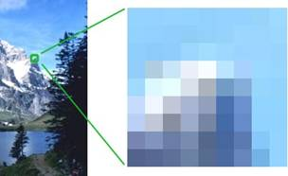
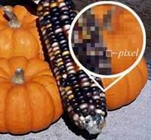
Bitmap Images
Bitmap images (also called raster images) are made with pixels (picture element), which look like rectangles.
A pixel is the smallest display
element that makes up the images seen on televisions and computer monitors.
All the pixels, when combined for visual images, are called continuous tone images (contones). A digital image (photograph or movie is a Contone.

Slide 12
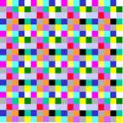
Bitmap Images
Resolution is the number of pixels in an image and is referred to as dpi or dots per inch. Resolution is based on the number of pixels in an image, which is determined, by its width and height of the pixels.
Example: Image size = width in pixels x height in pixels
Bitmap images are resolution dependent, and this must be taken into consideration when producing images of different size and quality.

Slide 13
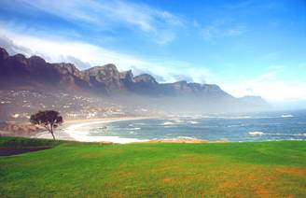
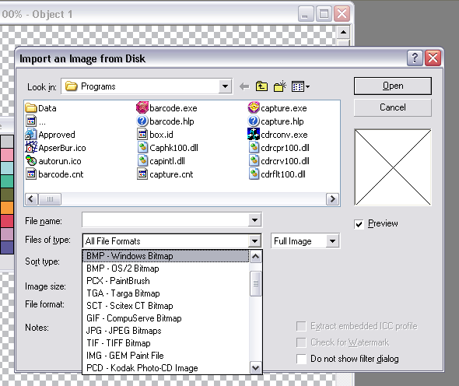
Advantages of Bitmap Images
Bitmap images are easily converted to different formats.
Bitmap images are easier to import into different software applications.
Bitmap images produce a variety of continuous tone images.
Bitmap images are better suited for most high quality renderings and web page graphics.

Slide 14
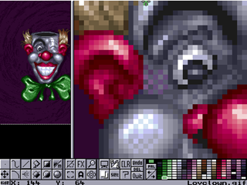

Disadvantages of Bitmap Images.
Bitmap images produce larger files sizes.
Bitmap images have restrictions in regards to alterations and modifications such as scale, image distortion, and format conversion.
There is a common appearance of blocked or jagged edges and blurriness in the image, which must be compensated for with sharpness filters.

Slide 15
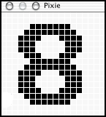
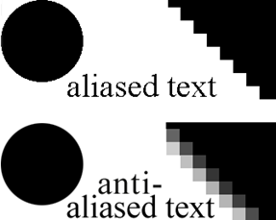
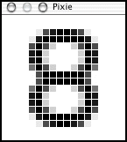
Disadvantages of Bitmap Images.
Substantial memory is required to work with bitmap images.
When bitmap images are enlarged, jagged, stair-stepped edges called aliasing appear.
Anti-aliasing is available in some programs to help smooth jagged edges.

Slide 16
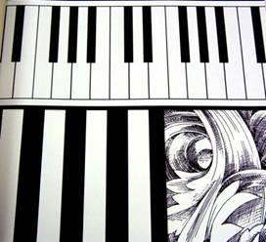
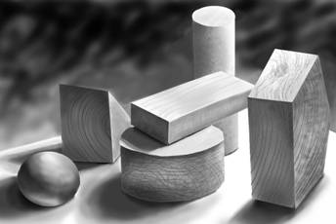
Basic Types of Bitmap Images
Black and white images called line art are simple 1-bit images.
Grayscale images contain various shades of gray as well as black and white.

Slide 17
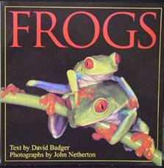
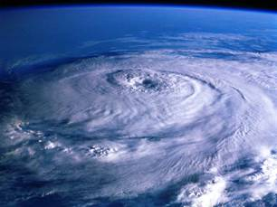
Basic Types of Bitmap Images
Full color images use color information that can be described using a number of color spaces such as RGB, CMYK or Lab colors.

Slide 18
Color Depth (bit depth)
Color depth refers to the number of “colors” available and/or the amount of computer memory that will be required to store pixel values of an image.
A bit (binary digit) is the smallest unit of information used in a computer. The signal can be on or off, 1 or 0
The higher the bit number, the more colors you have available, but the more computer memory required to store the image. File size should be considered when saving, creating, and scanning an image.

Slide 19
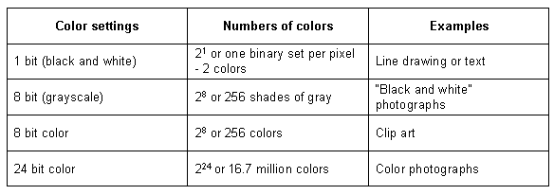
Color Depth Settings

Slide 20
Image Resolution
Image resolution is how sharp or clear an image is.
Multiply the number of pixels across by the number of pixels up and down to find the total number on your screen.
Pixels are picture elements or the dots on the monitor. Your monitor is set to a certain number of pixels and the pixels are a fixed size.
The more pixels that you have, the greater the memory needed to handle the display.
Image resolution is measured in dots per inch (dpi) for printing and pixels per inch (ppi) for monitor displays.

Slide 21
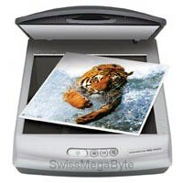
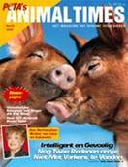

Image Resolution
The pixels per inch of a screen image translate directly into dots per inch on a printer. A 72-ppi image that would look fine on a monitor would look fuzzy when printed at 72 dpi.
It is important to scan images to match the proposed output for the best image quality.
For example, an image that is to be printed should be scanned at a minimum of 300 dpi.
300 dpi
72 dpi

Slide 22
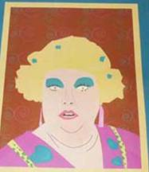
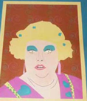
Image resolution
Resolution refers to image quality and sharpness. The higher the resolution, the larger the file size, but the clearer the image.
Images displayed on a monitor may not correlate with printed output size. Usually the printed image will be smaller than the screen image because of the higher printing resolution.
Web images are typically around 72 ppi. Printed images are generally 300 dpi or greater. Monitor images are approximately 70-100 ppi.

